Slide 1
When to use which test
Maja Kuzman

Slide 2
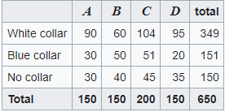
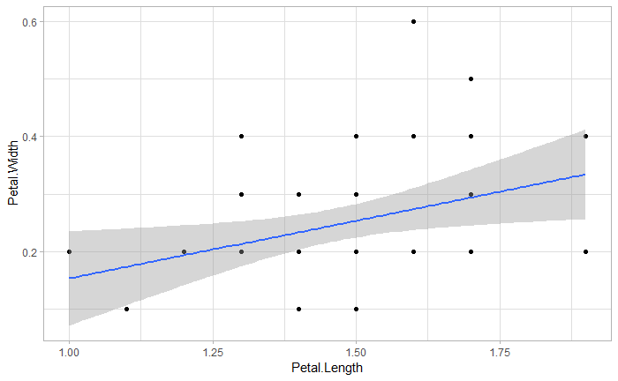


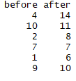
Chisq test for independence
Difference of proportions
Test for proportion
Regression analysis
Difference of means (independent)
Difference of means (paired)
Test for a mean

Slide 3
Things to consider when choosing a test:
1: Data
2: Samples
3. Purpose

Slide 4
Things to consider when choosing a test:
1: Data
2: Samples
3. Purpose
Notes:
What level of measurement

Slide 5
Things to consider when choosing a test:
1: Data
2: Samples
3. Purpose

Slide 6
Things to consider when choosing a test:
1: Data
2: Samples
3. Purpose

Slide 7
Things to consider when choosing a test:
Nominal
1: Data
Interval/Ratio

Slide 8

Nominal
Categorical
Qualitative
%
Notes:
Frequency, proportion, percentage

Slide 9
Chisq test for independence
Nominal
Difference of proportions
Test for proportion

Slide 10
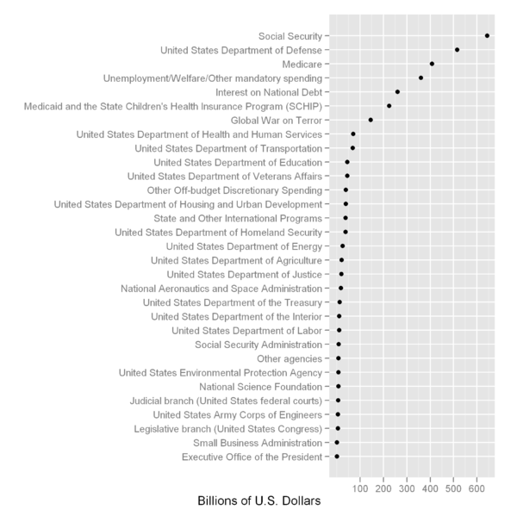
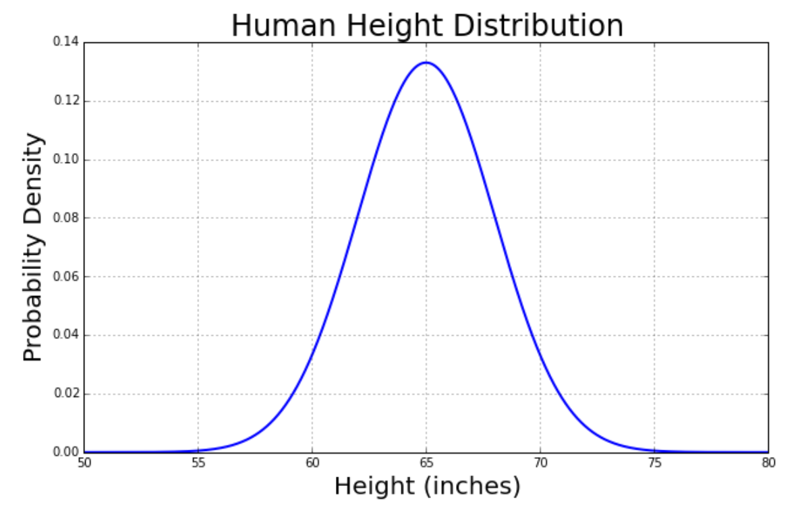
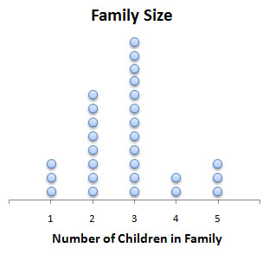
Quantitative
Interval/Ratio
Notes:
Most common way to summarize this data is by using the mean value or median value.

Slide 11
Regression analysis
Difference of means (independent)
Difference of means (paired)
Test for a mean

Slide 12
Things to consider when choosing a test:
2: Samples

Slide 13
One sample

Slide 14
Test for proportion
Test for a mean
One sample

Slide 15
 | white | black | Total
sampleA | 15 | 18 | 33
sampleB | 22 | 9 | 31
Total | 37 | 27 | 64
sampleA
61 4 7 3 6 44 33 12 42
sampleB
13 1 4 12 15 5
Two samples

Slide 16
Difference of proportions
 | white | black | Total
sampleA | 15 | 18 | 33
sampleB | 22 | 9 | 31
Total | 37 | 27 | 64
Difference of means (independent)
sampleA
61 4 7 3 6 44 33 12 42
sampleB
13 1 4 12 15 5
Two samples

Slide 17
People ID | Gender | Preferred
1 | M | white
2 | M | black
3 | F | milk
4 | M | black
5 | M | black
6 | F | milk
ID | Petal Length | Petal Width
1 | 17 | 3.4
2 | 16.3 | 3.3
3 | 15.9 | 3.2
4 | 18.2 | 3.6
5 | 16.88 | 3.4
6 | 20 | 4
ID | Before treatment | After treatment
1 | 12.4 | 14.53
2 | 15.3 | 17.43
3 | 22.8 | 24.93
4 | 14.2 | 16.33
5 | 1.77 | 3.9
6 | 14.73 | 16.86
One sample with multiple measurement

Slide 18
Chisq test for independence
People ID | Gender | Preferred
1 | M | white
2 | M | black
3 | F | milk
4 | M | black
5 | M | black
6 | F | milk
ID | Petal Length | Petal Width
1 | 17 | 3.4
2 | 16.3 | 3.3
3 | 15.9 | 3.2
4 | 18.2 | 3.6
5 | 16.88 | 3.4
6 | 20 | 4
Regression analysis
ID | Before treatment | After treatment
1 | 12.4 | 14.53
2 | 15.3 | 17.43
3 | 22.8 | 24.93
4 | 14.2 | 16.33
5 | 1.77 | 3.9
6 | 14.73 | 16.86
Difference of means (paired)
One sample with multiple measurement

Slide 19
Things to consider when choosing a test:
3. Purpose

Slide 20
Test for proportion
Testing against a hypothesized value
Difference of means (paired)
Test for a mean

Slide 21
Difference of proportions
Difference of means (independent)
Comparing two statistics (summary values)

Slide 22
Chisq test for independence
Regression analysis
Looking for a relationship between values

Slide 23
Examples

Slide 24
Example: The tall people of Split
We are interested if people from the city of Split in Croatia are on average taller then the general population of Croatia. We measure 30 people from Split. Mean value for the rest of Croatia is 165.
Which test should we use?

Slide 25
Chisq test for independence
Difference of proportions
Test for proportion
Cathegorical data
Regression analysis
Difference of means (independent)
Numerical data
Difference of means (paired)
Test for a mean
One sample repeated measurements
Comparing statistics
Test one value against hypothesis
Two samples
One sample
Relationship

Slide 26
Chisq test for independence
Difference of proportions
set.seed(2)
peopleFromSplit <- rnorm(30,171,20)
peopleFromSplit
t.test(peopleFromSplit, mu = 165)
Test for proportion
Cathegorical data
Regression analysis
Difference of means (independent)
Test for a mean
Numerical data
Difference of means (paired)
One sample repeated measurements
Comparing statistics
Test one value against hypothesis
Two samples
One sample
Relationship

Slide 27
Example: A fair game
We want to figure out if casinos are trying to trick us. We calculated that the odds of getting two numbers that sum up to 7 is around 17%. We roll 2 dices 10 times and only get this sum once. Is this fair?
Which test should we use?

Slide 28
Chisq test for independence
Difference of proportions
Test for proportion
Cathegorical data
Regression analysis
Difference of means (independent)
Numerical data
Difference of means (paired)
Test for a mean
One sample repeated measurements
Comparing statistics
Test one value against hypothesis
Two samples
One sample
Relationship

Slide 29
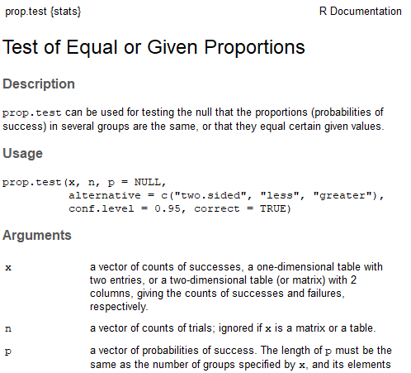
Chisq test for independence
Test for proportion
Cathegorical data
Regression analysis
Difference of means (independent)
Difference of proportions
Numerical data
Difference of means (paired)
Test for a mean
One sample repeated measurements
Comparing statistics
Test one value against hypothesis
Two samples
One sample
Relationship

Slide 30
Example: Dark chocolate is better.
We want to see if people like milk chocolate better then dark chocolate. We give dark chocolate to 50 people and ask them to grade it from 1 – 10. Then we give milk chocolate to the same people and ask for their opinion.
Which test should we use?

Slide 31
Chisq test for independence
Difference of proportions
Test for proportion
Cathegorical data
Regression analysis
Difference of means (independent)
Numerical data
Difference of means (paired)
Test for a mean
One sample repeated measurements
Comparing statistics
Test one value against hypothesis
Two samples
One sample
Relationship

Slide 32
Difference of means (paired)
T-test in R.
t.test(peoplesOpinions$darkChocolate, peoplesOpinions$milkChocolate, paired = T)
Difference of proportions
Test for proportion
Regression analysis
Difference of means (independent)

Slide 33
Difference of means (paired)
BE CAREFUL!
T-test in R.
t.test(peoplesOpinions$darkChocolate, peoplesOpinions$milkChocolate, paired = T)
Difference of proportions
Test for proportion
Regression analysis
Difference of means (independent)

Slide 34
Difference of means (paired)
Are the assumptions of t-test met?
allopinions <- c(milkChocolate, darkChocolate)
plot(density(allopinions))
shapiro.test(c(milkChocolate, darkChocolate))
Difference of proportions
Test for proportion
Regression analysis
Difference of means (independent)

Slide 35
Difference of means (paired)
Use wilcoxon sum rank test for non parametric distributions!
(also be careful about assumptions)
Difference of proportions
Test for proportion
Regression analysis
Difference of means (independent)
wilcox.test(peoplesOpinions$darkChocolate, peoplesOpinions$milkChocolate,
paired=T,
exact = F)

Slide 36
Example: If dark chocolate is not better you are doing it wrong.
We want to see if results from our experiment agrees with results from the other experiment. In our experiment, 28 out of 50 people preferred dark chocolate, while in the other one 70 out of a hundread prefer it.
Which test should we use?

Slide 37
Chisq test for independence
Difference of proportions
Test for proportion
Cathegorical data
Regression analysis
Difference of means (independent)
Numerical data
Difference of means (paired)
Test for a mean
One sample repeated measurements
Comparing statistics
Test one value against hypothesis
Two samples
One sample
Relationship

Slide 38
Chisq test for independence
Difference of proportions
prop.test(preferences)
Test for proportion
Regression analysis
Difference of means (independent)
Difference of means (paired)
Test for a mean

Slide 39
Example: If it’s free, I’m buying!
We are selling chocolate. We want to know if free samples are helping sales. One day we gave 80 free samples and we recorded the sales. Another day we did not give any free samples and we recorded the sales.
Which test should we use?

Slide 40
Chisq test for independence
Difference of means (independent)
... You know this one already ...
Difference of proportions
Test for proportion
Cathegorical data
Regression analysis
Numerical data
Difference of means (paired)
Test for a mean
One sample repeated measurements
Comparing statistics
Test one value against hypothesis
Two samples
One sample
Relationship
Notes:
Data: Numerical - for each day: sales
Samples: 2, day 1 and day 2 sales
Purpose: Test the means
Difference of means (independent)

Slide 41
Example: Men, right?
We want to see if women or men are affected more by the free samples. We recorded who bought the chocolate and if it was a day with free samples or no.
Which test should we use?

Slide 42
Chisq test for independence
Difference of proportions
Test for proportion
Cathegorical data
Regression analysis
Difference of means (independent)
Numerical data
Difference of means (paired)
Test for a mean
One sample repeated measurements
Comparing statistics
Test one value against hypothesis
Two samples
One sample
Relationship
Notes:
Great video: https://www.youtube.com/watch?v=rulIUAN0U3w&app=desktop

Slide 43
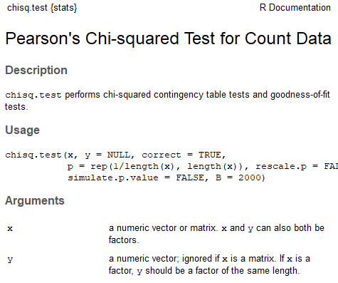
Chisq test for independence
Difference of proportions
Test for proportion
Cathegorical data
Regression analysis
Difference of means (independent)
Numerical data
Difference of means (paired)
Test for a mean
One sample repeated measurements
Comparing statistics
Test one value against hypothesis
Two samples
One sample
Relationship
Notes:
Great video: https://www.youtube.com/watch?v=rulIUAN0U3w&app=desktop

Slide 44
Example: If it’s free, I’m buying again!
Again we want to see what connection is there between free samples and sales of chocolate. We give different amounts of free samples for 15 days and record the sales for each day.
Which test should we use?

Slide 45
Chisq test for independence
Difference of proportions
Test for proportion
Cathegorical data
Regression analysis
Difference of means (independent)
Numerical data
Difference of means (paired)
Test for a mean
One sample repeated measurements
Comparing statistics
Test one value against hypothesis
Two samples
One sample
Relationship
Notes:
Data: Numerical - for each day: sales
Samples: 2, day 1 and day 2 sales
Purpose: Test the means
Difference of means (independent)

Slide 46
Chisq test for independence
Difference of proportions
Test for proportion
Regression analysis
Cathegorical data
Difference of means (independent)
library(ggplot2)
ggplot(salesTable, aes(freeSamples, salesThisDay))+
geom_point() +
geom_smooth(method="lm")+ theme_light()
Numerical data
Difference of means (paired)
Test for a mean
One sample repeated measurements
Comparing statistics
Test one value against hypothesis
Two samples
One sample
Relationship
Notes:
Data: Numerical - for each day: sales
Samples: 2, day 1 and day 2 sales
Purpose: Test the means
Difference of means (independent)

Slide 47
Chisq test for independence
Difference of proportions
Test for proportion
Regression analysis
Cathegorical data
To get this ourselves:
plot(salesTable$freeSamples, salesTable$salesThisDay)
linearModel <- lm( salesThisDay ~ freeSamples, data = salesTable)
summary(linearModel)
abline(linearModel$coefficients)
Difference of means (independent)
Numerical data
Difference of means (paired)
Test for a mean
One sample repeated measurements
Comparing statistics
Test one value against hypothesis
Two samples
One sample
Relationship
Notes:
Data: Numerical - for each day: sales
Samples: 2, day 1 and day 2 sales
Purpose: Test the means
Difference of means (independent)

Slide 48
A lot of resources and examples:
Practice scenarios: https://www.youtube.com/watch?v=QrYgXZf-Ay8
https://www.youtube.com/watch?v=rulIUAN0U3w&app=desktop
https://www.youtube.com/watch?v=UaptUhOushw

